Slide 1
Operating System Types
Mainframe OS
Server OS
Multiprocessor OS
Personal Computer OS
Handheld Computer OS
Embedded OS
Real-Time OS

Slide 2
Mainframe OS
http://mainframes.com/whatis.htm
Can have huge I/O capacity - mainframes with 1000s of disks and terabytes of data are common
Examples include OS/390, Z/OS, MULTICS, UNIX
  making a “comeback” as high-end WWW servers & servers for e-commerce sites
  OS are oriented to processing many jobs at once

Slide 3
Mainframe OS (continued)
Typically three kinds of services:
  Batch processing
    Processing routine jobs without any interaction
    E.g. claims processing in insurance company
  Transaction processing
    Processing large numbers of small requests
    E.g. airline reservations, check processing at a bank
  Timesharing
    Allows multiple remote users run jobs on the computer at once
    E.g. querying a big database

Slide 4
Server OS
Run on PCs, workstations or mainframes
Serve many users at once over a network
  allow users share hardware/software
  provide print, file, Web, database services
  Focus is primarily security and reliability
ISPs run many server machines to support customers
Web sites use servers to store Web pages & handle incoming requests
UNIX, Windows Server & Linux

Slide 5
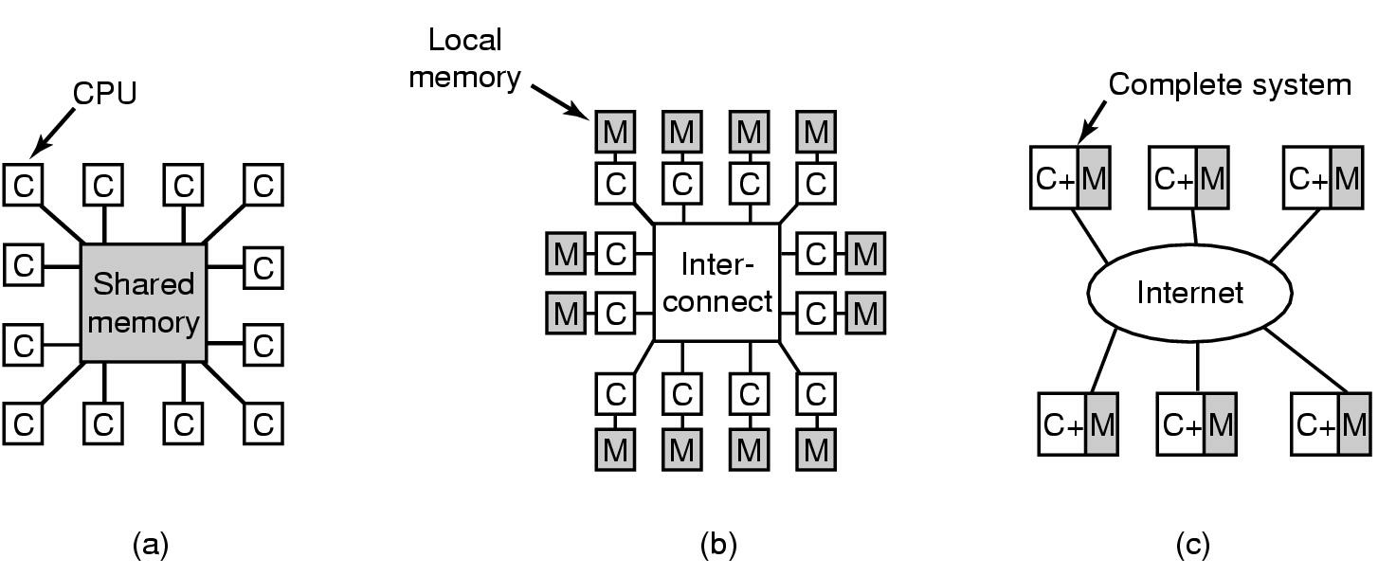
Multiprocessor OS
Multiprocessing means achieving greater computing power and reliability by connecting multiple CPUs into a single system sharing a common RAM
OS are required with special features for communication & connectivity
Recently multi-core CPU is
becoming available on PC
Many popular OSs e.g Windows
and Linux run on multiprocessors
Notes:
Multi-core – multiple cores on the one chip e.g. quad-core
L1 cache – inside the CPU
L2 cache – on multicore chips, each core can have its own L2 cache or the L2 cache can be shared

Slide 6
Personal Computer OS
Single-user systems for the most part
Supports multiprogramming
Easy to use interface the key requirement
Used for
  word processing, spreadsheets, WWW browsing, coding etc.
Examples are
  Windows 98/2000/XP/Vista
  Windows 7
  MAC OS/X
  Linux

Slide 7
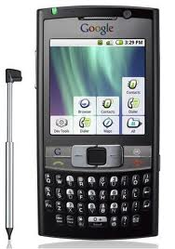
HandHeld Computer Operating Systems
E.g. smartphone/tablet OSs
iOS for iPhone
Android developed by Google
Windows Phone 8
OS for mobile combines features of a PC OS with:
  Touchscreen
  Cellular
  Wi-Fi
  Camera
  App store (thousands of apps available)
  etc
Notes:
Modern mobile operating systems combine the features of a personal computer operating system with other features, including a touchscreen, cellular, Bluetooth, Wi-Fi, GPS mobile navigation, camera, video camera, speech recognition, voice recorder, music player, near field communication

Slide 8
Embedded OS
Embedded systems run on computers that control devices not generally thought of as computers
E.g. TV sets, microwave ovens, cars
OS is in ROM
Size, memory and power restrictions
Example Windows CE

Slide 9
Real-Time OS
Time is a key parameter
E.g. in industrial process control systems
E.g. a car must be available for a robot on an assembly line
Airbag must get inflated at appropriate time, otherwise it may be fatal for a driver.
Also used in air traffic control, missile guidance systems or health monitoring systems - a missed response can have catastrophic consequences

Slide 10
Differences between OSs
Desirable features in a time-shared system (e.g. resource sharing) may be detrimental in a real-time system where minimization of delays discourages resource sharing

